Slide 1
Window to your soul: A VR horror show
By Brent Blihovde
Arindam Bose
Deep Ghosh

Slide 2
Game Mechanics
Sanity Effects
Pulsating Lighting
Wall’s closing down
Pulsating Screen Blur
Enemies
Pumpkins
Static Fireball Throwing Skeletons
Moving fireball throwing skeletons with flamethrowers
Resource Management
Sanity
Sprint Energy
Flashlight Battery
Simple Puzzle Mechanics
Map
Key Finding
Notes:
How presentation is organized
Key sections in our game

Slide 3
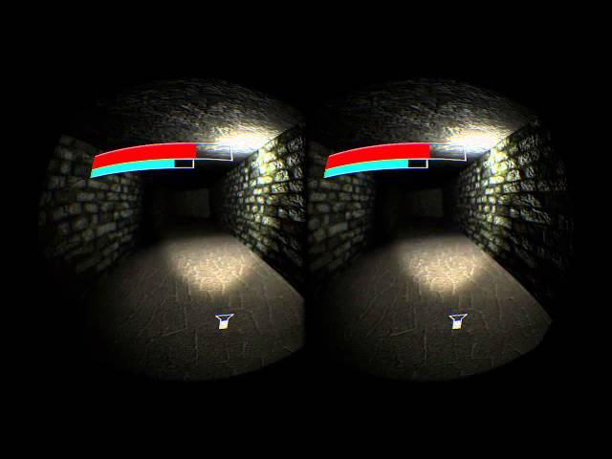
Sanity Effects
Effects aggravate as you lose sanity
Notes:
In game effects as you lose sanity
the more sanity you lose more the effects aggravate
aggravated effects make it harder to play
Motivation for the player to keep his sanity high
Talk about implementation of each effect and issues in each

Slide 4
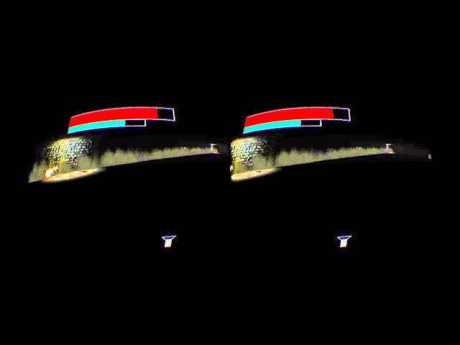
Enemies
Designed to take advantage of the ability to look around in the rift
Damage your sanity

Slide 5
Resource Management
Sanity
Slow loss over time
Regenerates if you stay in the light of the wisp
Wisp also provides a guiding light and a motivation for the player to complete the game
Balance of moving away from the wisp to avoid enemies and losing sanity.
Sprint Energy
Lose quickly but regenerate quicker
Incentivises small quick movements without long dashes
Flashlight Battery
Slowly degenerates over time
Player must save it up for darker sections

Slide 6
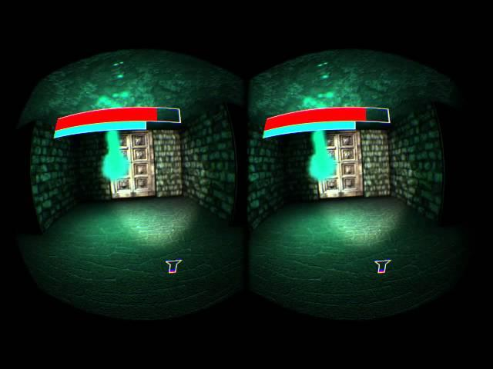
Resource Management
(Video)
Notes:
Describe each effect and talk about the wisp

Slide 7
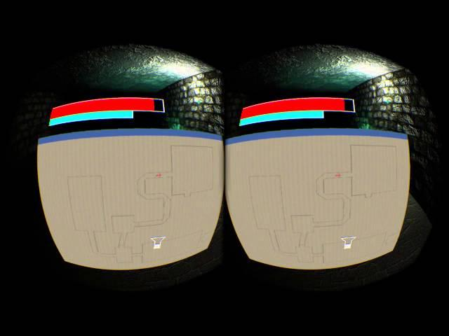
Simple Puzzle Mechanics
Simple key finding- locked door puzzles to incentivise the player to explore additional sections on the level
A map shows the locations of the keys and the player in the level to provide an objective on where to go.
Wisp moves through locked doors making the player go around exploring.
Players can spray X’s on the walls to mark where they have been.

Slide 8
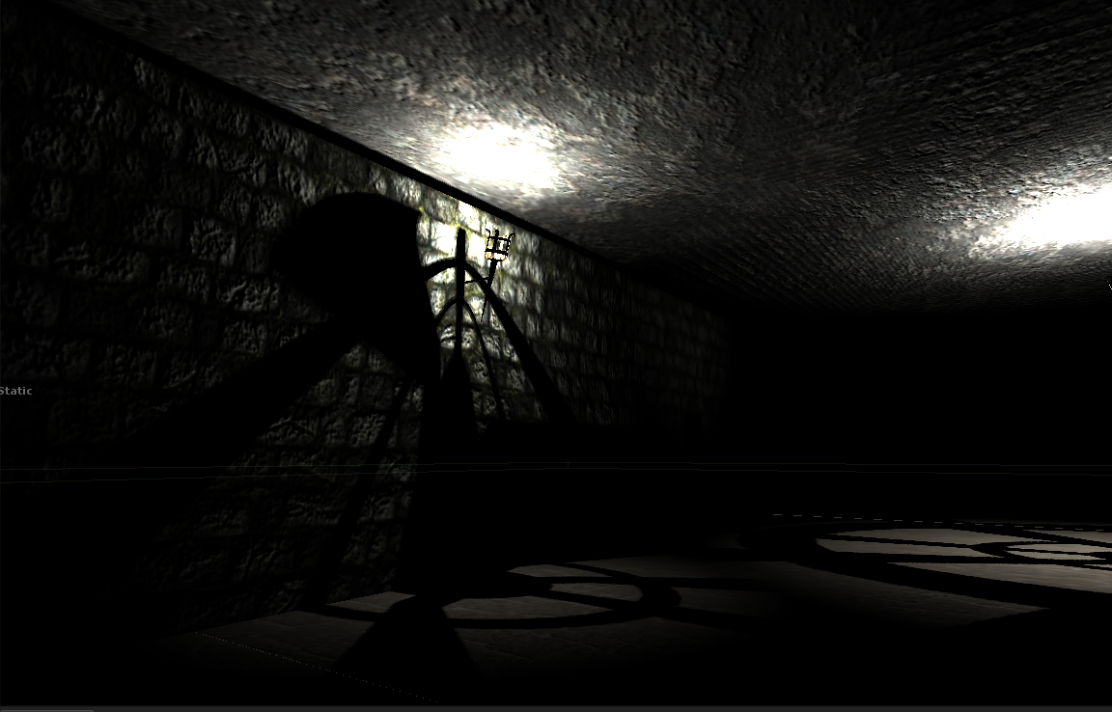
Polish Effects
Graphics
SSAO
2048x2048 textures
Bump Mapping everything
Deferred Lighting

Slide 9
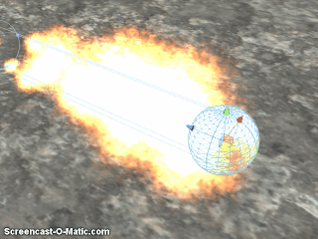
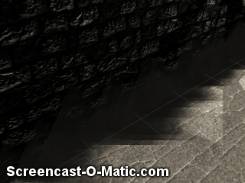
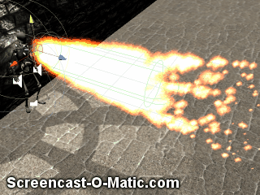
Polish Effects
Particles
Fireball
Flamethrower
Wisp
Wall Dust

Slide 10
Polish Effects
Audio
Directional HRTF based
Audio cue’s for pumpkins, fireball’s, door’s being locked, skeletons moving around, walls moving
Background Audio

Slide 11
Conclusion
Key takeaways and lessons learned:
Playtesting ( with a wider audience ) is important
Other people not comfortable with input paradigms we are comfortable with(WASD+Mouse).
Environmental- puzzle based gameplay is hard to balance in the given time frame.
Had to switch to a faster paced action based gameplay.
In retrospect would have worked on the final idea from the start.

Slide 12
Balance Changes
Pumpkins do less damage
Fix to game end trigger
Lesser enemies in the static and moving skeleton rooms.

Slide 13
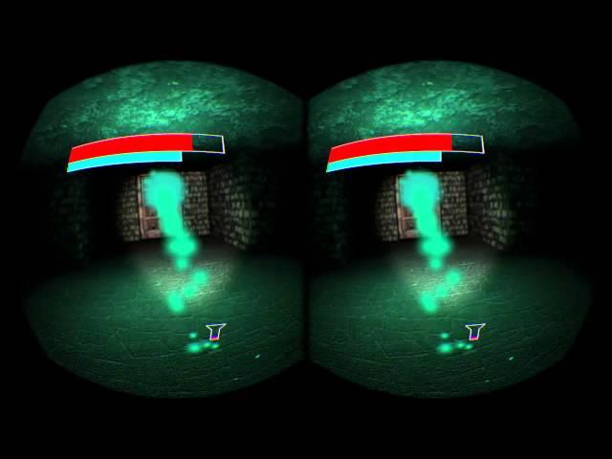
Playthrough Video

